Slide 1


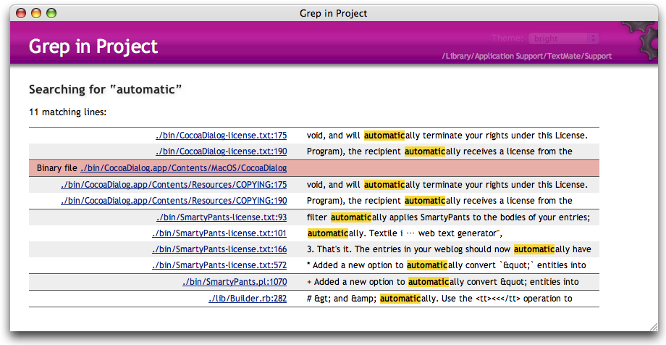
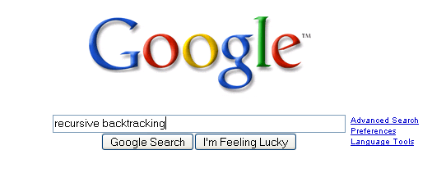
Searching
CLRS, Sections 9.1 – 9.3

Slide 2

Linear Search
Given a list of data, find the location of a particular value or report that value is not present
Linear search
Intuitive approach:
Start at first item.
Is it the one I am looking for?
If not, go to next item.
Repeat until found or all items checked.
If items not sorted or unsortable, this approach is necessary.

Slide 3
The Search Problem
Given a list of values list storing n numbers, and a target value target, locate position of target in list if it exists.
Example
Input: list = {3,8,2,15,99,52}, target = 99
Output: position 4
Notes
List indexes go from 0...n-1.
When the target does not exist in the array, return an undefined position, such as -1.

Slide 4
Linear Search Code
/* return the index of the first occurrence
of target in list, or -1 if target not present in
list
*/
public int linearSearch(int list[], int target)
{
int i = 0;
while(i < list.length && list[i] != target)
i++;
if(i >= list.length)
return -1;
else
return i;
}

Slide 5
Question 1
What is the average case Big-O of linear search in an array with n items, if an item is present?
O(n)
O(n²)
O(1)
O(log(n))
O(n log(n))

Slide 6
Question 1
What is the average case Big-O of linear search in an array with n items, if an item is present?
O(n)
O(n²)
O(1)
O(log(n))
O(n log(n))

Slide 7
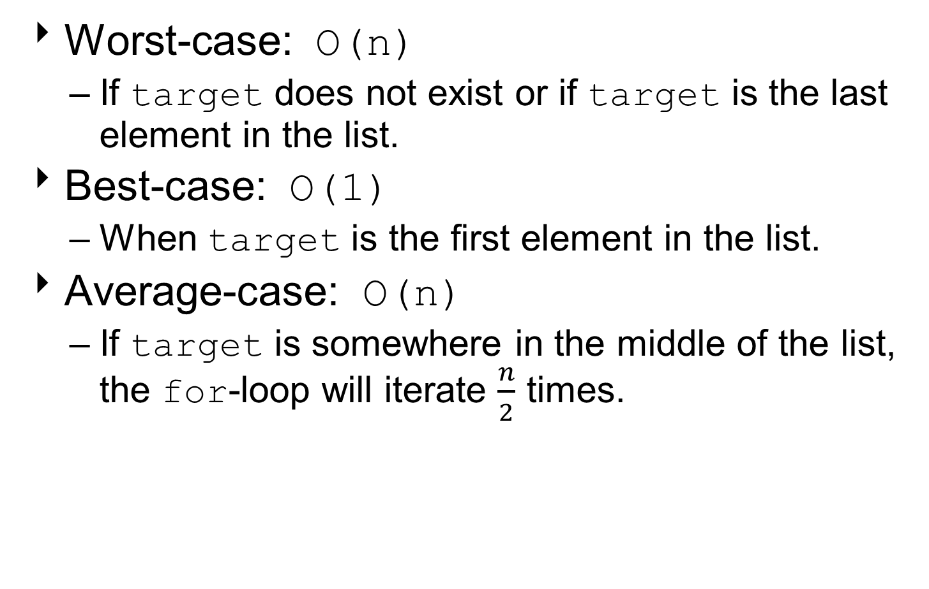
Linear Search Time Complexity
Worst-case: O(n)
If target does not exist or if target is the last element in the list.
Best-case: O(1)
When target is the first element in the list.
Average-case: O(n)
If target is somewhere in the middle of the list, the for-loop will iterate $\frac{n}{2}$ times.

Slide 8
Searching in Sorted Lists
Suppose the list is arranged in increasing or non-decreasing order.
Linear search on a sorted array still yields the same analysis:
O(n) worst-case time complexity.
Can exploit sorted structure by performing binary search.

Slide 9
Searching in Sorted List
If items are sorted, we can divide and conquer.
Dividing your work in half with each step.
Generally a good thing.
The Binary Search on list in ascending order:
Start at middle of list.
Is that the item?
If not, is it less than or greater than the item?
Less than, move to second half of list.
Greater than, move to first half of list.
Repeat until found or sub-list size = 0.

Slide 10
Binary Search
list
low item middle item high item
Is middle item what we are looking for?
If not, is it more or less than the target?
If lower…
list
low middle high item item item
and so forth…

Slide 11
Binary Search I
Given target and sorted array list[], find index i such that list[i] = target, or report that no such index exists.
Example 1: Search for 33.
6
13
14
25
33
43
51
53
64
72
84
93
95
96
97
0
1
2
3
4
5
6
7
8
9
10
11
12
13
14
lo
hi

Slide 12
Binary Search I
33 < 53, so look in lower half.
6
13
14
25
33
43
51
53
64
72
84
93
95
96
97
0
1
2
3
4
5
6
7
8
9
10
11
12
13
14
lo
mid
hi

Slide 13
Binary Search I
6
13
14
25
33
43
51
53
64
72
84
93
95
96
97
0
1
2
3
4
5
6
7
8
9
10
11
12
13
14
lo
hi

Slide 14
Binary Search I
25 < 33, so look in upper half.
6
13
14
25
33
43
51
53
64
72
84
93
95
96
97
0
1
2
3
4
5
6
7
8
9
10
11
12
13
14
lo
mid
hi

Slide 15
Binary Search I
6
13
14
25
33
43
51
53
64
72
84
93
95
96
97
0
1
2
3
4
5
6
7
8
9
10
11
12
13
14
lo
hi

Slide 16
Binary Search I
43 < 33, so look in lower half.
6
13
14
25
33
43
51
53
64
72
84
93
95
96
97
0
1
2
3
4
5
6
7
8
9
10
11
12
13
14
lo
mid
hi

Slide 17
Binary Search I
6
13
14
25
33
43
51
53
64
72
84
93
95
96
97
0
1
2
3
4
5
6
7
8
9
10
11
12
13
14
lo hi

Slide 18
Binary Search I
33 = 33, so found value.
6
13
14
25
33
43
51
53
64
72
84
93
95
96
97
0
1
2
3
4
5
6
7
8
9
10
11
12
13
14
lo hi mid

Slide 19
Binary Search I
Done.
6
13
14
25
33
43
51
53
64
72
84
93
95
96
97
0
1
2
3
4
5
6
7
8
9
10
11
12
13
14
lo hi mid

Slide 20
Binary Search II
Example 2: Search for 90.
6
13
14
25
33
43
51
53
64
72
84
93
95
96
97
0
1
2
3
4
5
6
7
8
9
10
11
12
13
14
lo
hi

Slide 21
Binary Search II
90 > 53, so look in upper half.
6
13
14
25
33
43
51
53
64
72
84
93
95
96
97
0
1
2
3
4
5
6
7
8
9
10
11
12
13
14
lo
mid
hi

Slide 22
Binary Search II
6
13
14
25
33
43
51
53
64
72
84
93
95
96
97
0
1
2
3
4
5
6
7
8
9
10
11
12
13
14
lo
hi

Slide 23
Binary Search II
90 < 93, so look in lower half.
6
13
14
25
33
43
51
53
64
72
84
93
95
96
97
0
1
2
3
4
5
6
7
8
9
10
11
12
13
14
lo
mid
hi

Slide 24
Binary Search II
6
13
14
25
33
43
51
53
64
72
84
93
95
96
97
0
1
2
3
4
5
6
7
8
9
10
11
12
13
14
lo
hi

Slide 25
Binary Search II
90 > 72, so look in upper half.
6
13
14
25
33
43
51
53
64
72
84
93
95
96
97
0
1
2
3
4
5
6
7
8
9
10
11
12
13
14
lo
mid
hi

Slide 26
Binary Search II
6
13
14
25
33
43
51
53
64
72
84
93
95
96
97
0
1
2
3
4
5
6
7
8
9
10
11
12
13
14
lo hi

Slide 27
Binary Search II
90 > 84, so look in upper half?
6
13
14
25
33
43
51
53
64
72
84
93
95
96
97
0
1
2
3
4
5
6
7
8
9
10
11
12
13
14
lo hi mid

Slide 28
Binary Search II
lo > hi, so no list left to search.
Done.
6
13
14
25
33
43
51
53
64
72
84
93
95
96
97
0
1
2
3
4
5
6
7
8
9
10
11
12
13
14
hi
lo

Slide 29
Recursive Binary Search
public static int search(int list[], int target)
{ return b-search(list, target, 0, list.length – 1);
}
public static int b-search(int list[], int target,
int low, int high)
{
if( low <= high )
{
int mid = low + ((high - low) / 2);
if( list[mid] == target )
return mid;
else if( list[mid] > target )
return b-search(list, target, low, mid – 1);
else
return b-search(list, target, mid + 1, high);
}
return -1;
}

Slide 30
Question 2
What is the worst case Big O of binary search in an array with n items, if an item is present?
O(n)
O(n²)
O(1)
O(log(n))
O(n log(n))

Slide 31
Question 2
What is the worst case Big O of binary search in an array with n items, if an item is present?
O(n)
O(n²)
O(1)
O(log(n))
O(n log(n))

Slide 32
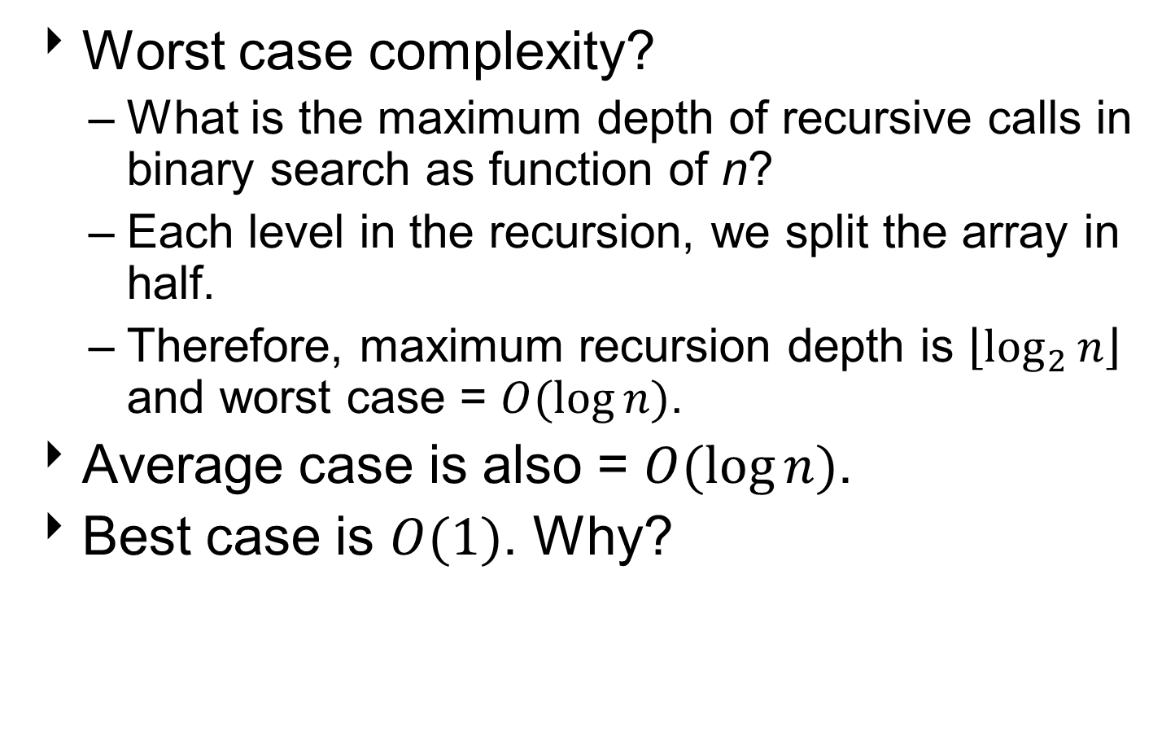
Binary Search: Analysis
Worst case complexity?
What is the maximum depth of recursive calls in binary search as function of n?
Each level in the recursion, we split the array in half.
Therefore, maximum recursion depth is $\left\lfloor \log_{2}{n}\right\rfloor$ and worst case = $O(\log{n)}$.
Average case is also = $O(\log{n)}$.
Best case is $O(1)$. Why?

Slide 33
Can We Do Better?
Average and worst case of linear search = O(n).
Average and worst case of binary search = O(log n).
Can we do better than this?
YES. Use a hash table! Discuss this later in the semester.

Slide 34
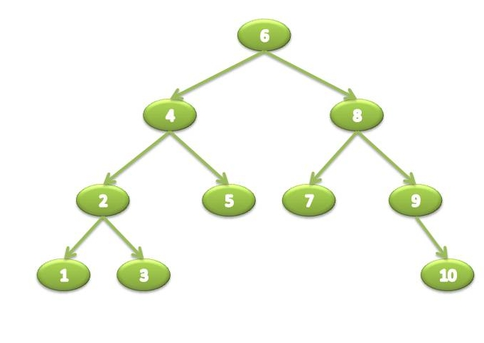
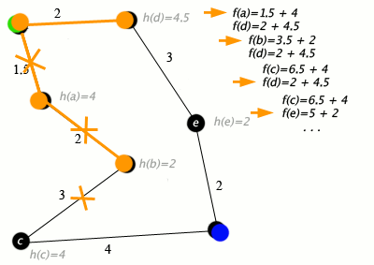
Other Searching Algorithms
Interpolation Search
More like what people really do.
Binary Search Trees
Hash Table Searching
Heuristic Search
Notes:
Interpolation Search: Interpolation search is an algorithm for searching for a given key in an indexed array that has been ordered by numerical values assigned to the keys (key values). It parallels how humans search through a telephone book for a particular name, the key value by which the book's entries are ordered. In each search step it calculates where in the remaining search space the sought item might be, based on the key values at the bounds of the search space and the value of the sought key, usually via a linear interpolation. The key value actually found at this estimated position is then compared to the key value being sought. If it is not equal, then depending on the comparison, the remaining search space is reduced to the part before or after the estimated position. This method will only work if calculations on the size of differences between key values are sensible. [Wikipedia]
Binary Search Trees: Binary search trees keep their keys in sorted order, so that lookup and other operations can use the principle of binary search: when looking for a key in a tree (or a place to insert a new key), they traverse the tree from root to leaf, making comparisons to keys stored in the nodes of the tree and deciding, based on the comparison, to continue searching in the left or right subtrees. On average, this means that each comparison allows the operations to skip about half of the tree, so that each lookup, insertion or deletion takes time proportional to the logarithm of the number of items stored in the tree. This is much better than the linear time required to find items by key in an (unsorted) array, but slower than the corresponding operations on hash tables. [Wikipedia]
Hash Tables: Hash table (hash map) is a data structure, which implements an associative array abstract data type, a structure that can map keys to values. A hash table uses a hash function to compute an index into an array of buckets or slots, from which the desired value can be found. Ideally, the hash function will assign each key to a unique bucket, but most hash table designs employ an imperfect hash function, which might cause hash collisions, where the hash function generates the same index for more than one key. Such collisions must be accommodated in some way. In a well-dimensioned hash table, the average cost for each lookup is independent of the number of elements stored in the table. [Wikipedia]
Best-First: Best-first search is a search algorithm which explores a graph by expanding the most promising node chosen according to a specified rule. [Wikipedia]
A*: A* (pronounced as "A star") is a computer algorithm that is widely used in pathfinding and graph traversal, the process of plotting an efficiently directed path between multiple points, called nodes. It enjoys widespread use due to its performance and accuracy. However, in practical travel-routing systems, it is generally outperformed by algorithms which can pre-process the graph to attain better performance, although other work has found A* to be superior to other approaches. [Wikipedia]

Slide 35
Heuristic Search Techniques
Direct techniques (blind search) are not always possible (they require too much time or memory).
Weak techniques can be effective if applied correctly on the right kinds of tasks.
Typically require domain specific information.

Slide 36
Example: 8 Puzzle
1
2
3
1
2
3
7
8
4
8
4
6
5
7
6
5

Slide 37
Which move is best?
1
2
3
GOAL
1
2
3
8
4
7
8
4
7
6
5
6
5
left
up
right
1
2
3
1
2
3
1
2
3
7
8
4
7
8
4
7
4
6
5
6
5
6
8
5

Slide 38
8 Puzzle Heuristics
Blind search techniques used an arbitrary ordering (priority) of operations.
Heuristic search techniques make use of domain specific information - a heuristic.
What heurisitic(s) can we use to decide which 8-puzzle move is “best” (i.e. worth considering first)?

Slide 39
8 Puzzle Heuristics
For now - we just want to establish some ordering to the possible moves (the values of our heuristic does not matter as long as it ranks the moves).
Later - we will worry about the actual values returned by the heuristic function.

Slide 40
A Simple 8-puzzle Heuristic
Number of tiles in the correct position.
The higher the number the better.
Easy to compute (fast and takes little memory).
Probably the simplest possible heuristic.

Slide 41
Another Approach
Number of tiles in the incorrect position.
This can also be considered a lower bound on the number of moves from a solution!
The “best” move is the one with the lowest number returned by the heuristic.
Is this heuristic more than a heuristic (is it always correct?).
Given any 2 states, does it always order them properly with respect to the minimum number of moves away from a solution?

Slide 42
1
2
3
GOAL
1
2
3
8
4
7
8
4
7
6
5
6
5
left
up
right
1
2
3
1
2
3
1
2
3
7
8
4
7
8
4
7
4
6
5
6
5
6
8
5
h=2
h=4
h=3

Slide 43
Another 8-puzzle Heuristic
Count how far away (i.e. how many tile movements) each tile is from it’s correct position.
Sum up this count over all the tiles.
This is another estimate on the number of moves away from a solution.

Slide 44
1
2
3
GOAL
1
2
3
8
4
7
8
4
7
6
5
6
5
left
up
right
1
2
3
1
2
3
1
2
3
7
8
4
7
8
4
7
4
6
5
6
5
6
8
5
h=2
h=4
h=4

Slide 45
Techniques
There are a variety of search techniques that rely on the estimate provided by a heuristic function.
In all cases - the quality (accuracy) of the heuristic is important in real-life application of the technique!

Slide 46
Generate-and-test
Very simple strategy - just keep guessing.
Do while goal not accomplished
Generate a possible solution
Test solution to see if it is a goal
Heuristics may be used to determine the specific rules for solution generation.
Notes:
Generating a solution may mean moving in the state space, or perhaps constructing a path through the state space. The path may end at a goal state, in which case we are done.
If a systematic mechanism for generation is used the algorithm can always find the best solution.
Random generation may work in some domains.
Depth first search since complete solutions are generated before they can be tested.

Slide 47
Example - Traveling Salesman Problem (TSP)
Traveler needs to visit n cities.
Know the distance between each pair of cities.
Want to know the shortest route that visits all the cities once.
n=80 will take millions of years to solve exhaustively!

Slide 48
TSP Example
A
B
6
1
2
5
3
D
C
4
Notes:
ABCD = 18
BACD = 13 - take it
ABCD = 18 - nope
BCAD - 11 - take it (is the optimum)
CBAD - 18
BACD - 13
BCDA - 18
DCAB - 13 nope

Slide 49
Generate-and-Test Example
TSP - generation of possible solutions is done in lexicographical order of cities:
1. A - B - C - D
2. A - B - D - C
3. A - C - B - D
4. A - C - D - B
...
A
B
C
D
B
C
D
C
D
B
D
C
B
D
C
D
B
B
C
Notes:
Characteristics with generate-and-test:
Requires that an entire possible solution is generated at each step, which may
be expensive
It may be difficult to develop a generation scheme that provides a
good order.
The big problem is that the algorithm is blind - it does not make use of any
knowledge that becomes available during the search.
1. Can modify to use brand-and-bound techniques to skip some solutions.
2. Perhaps we can use information about the likelyhood of success to change
the generated possible solutions.
IMPORTANT: TSP is a bad example because it is hard to see the state space. Consider a problem like the water jug problem and describe how this algorithm would work in that domain.

Slide 50
Hill Climbing
Variation on Generate-and-Test:
Generation of next state depends on feedback from the test procedure.
Test now includes a heuristic function that provides a guess as to how good each possible state is.
There are a number of ways to use the information returned by the test procedure.
Notes:
The term hill climbing assumes we are talking about finding a maximum, but the concepts apply to minimization problems as well.
Remember that the heuristic is a rule of thumb or guess based on less than complete information. We assume that construction of a perfect heuristic is impossible (otherwise it would be the search).

Slide 51
Simple Hill Climbing
Use heuristic to move only to states that are better than the current state.
Always move to better state when possible.
The process ends when all operators have been applied and none of the resulting states are better than the current state.
Notes:
Always climb uphill whenever you can, without looking around.
Climbing a mountain in the dark - test one direction and if it is uphill take a step in that direction. If you find that there is no uphill move in any direction you are done (at the top of the mountain).

Slide 52
Simple Hill Climbing Function Optimization
y = f(x)
y
x
Notes:
Assuming the heuristic can be viewed as a function of the current state, all heuristic search can be modeled as function optimization in which we wish to
maximize/minimize the value of the heuristic function.
NOTES:
must define the operators!
Small move left, big move left, large moves, etc.
Change the order of operators and see what happens.
“climbing” vs. “descending” - same problem.

Slide 53
Potential Problems with Simple Hill Climbing
Will terminate when at local optimum.
The order of application of operators can make a big difference.
Can’t see past a single move in the state space.

Slide 54
Simple Hill Climbing Example
TSP - define state space as the set of all possible tours.
Operators exchange the position of adjacent cities within the current tour.
Heuristic function is the length of a tour.
Notes:
Note the transformation of the state space into one that involves a potential solution at each state. This will result in something different than if we
define the state space as incomplete tours!

Slide 55
TSP Hill Climb State Space
ABCD
Initial State
Swap 1,2
Swap 2,3
Swap 3,4
Swap 4,1
BACD
ACBD
ABDC
DBCA
Swap 1,2
Swap 3,4
Swap 2,3
Swap 4,1
CABD
ABCD
ACDB
DCBA
Notes:
Lots of loops
Each tour has many representations (toy problem)!

Slide 56
Steepest-Ascent Hill Climbing
A variation on simple hill climbing.
Instead of moving to the first state that is better, move to the best possible state that is one move away.
The order of operators does not matter.
Not just climbing to a better state, climbing up the steepest slope.
Notes:
Go through examples:
function optimization - choice of points fixes valley problem.
Multidimensional problems
TSP - new order of states. Example will find best right awat.

Slide 57
Hill Climbing Termination
Local Optimum: all neighboring states are worse or the same.
Plateau - all neighboring states are the same as the current state.
Ridge - local optimum that is caused by inability to apply 2 operators at once.
Notes:
Example of ridge is clear in the water jug problem.
Need to define a heuristic for the water jug problem that takes this in to account.

Slide 58
Heuristic Dependence
Hill climbing is based on the value assigned to states by the heuristic function.
The heuristic used by a hill climbing algorithm does not need to be a static function of a single state.
The heuristic can look ahead many states, or can use other means to arrive at a value for a state.
Notes:
The point is that the hill climbing is with respect to the heuristic function, which may not be directly related to the immediate value of a single state.
Example: TSP - could have a heuristic that looks at the path 4 cities ahead.
Example: Could devise a heuristic that looks for ridges in the simple evaluation space and adds a “ridge factor”.
Example: Can use constraints to modify the heuristic function - penalties for points that are not feasible.
Can transform the optimization function to one with better characteristics (perhaps fewer local optimum), although at a cost. The search is basically a bunch of calls to the heuristic function, so the cost of this function is critical.

Slide 59
Best-First Search
Combines the advantages of Breadth-First and Depth-First Searches.
DFS: follows a single path, don’t need to generate all competing paths.
BFS: doesn’t get caught in loops or dead-end-paths.
Best First Search: explore the most promising path seen so far.

Slide 60
Best-First Search
While goal not reached:
Generate all potential successor states and add to a list of states.
Pick the best state in the list and go to it.
Similar to steepest-ascent, but don’t throw away states that are not chosen.
Notes:
Space requirements are a problem...
Modified version called “beam search” keeps on the N most promising states around.

Slide 61
Simulated Annealing
Based on physical process of annealing a metal to get the best (minimal energy) state.
Hill climbing with a twist:
Allow some moves downhill (to worse states).
Start out allowing large downhill moves (to much worse states) and gradually allow only small downhill moves.
Notes:
Proability of jumping to a state of higher energy is given by exponential function p = exp(-deltaE/t).

Slide 62
Simulated Annealing
The search initially jumps around a lot, exploring many regions of the state space.
The jumping is gradually reduced and the search becomes a simple hill climb (search for local optimum).
Notes:
Algorithm:
use next operator to generate a new state.
Evaluate the state (heuristic function)
with probability p(t), move to the better state.
P(t) is roughly exponentially decreasing with respect to time (number of steps).

Slide 63
Simulated Annealing
7
6
2
4
3
5
1
Notes:
Marble analogy - increased temperature means we are shaking the curve around so that it can bound out of troughs. As temperature decreases - bounces are not so high, so we get trapped by the largest peaks...

Slide 64
A* Algorithm
The A* algorithm uses a modified evaluation function and a Best-First search.
A* minimizes the total path cost.
Under the right conditions A* provides the cheapest cost solution in the optimal time!

Slide 65
A* evaluation function
The evaluation function f is an estimate of the value of a node x given by:
f(x) = g(x) + h’(x)
g(x) is the cost to get from the start state to state x.
h’(x) is the estimated cost to get from state x to the goal state (the heuristic).
Notes:
Some notes about g and h’
If g is 0, this is just a greedy algorithm - it always picks what looks like the most promising path to the goal.
If h’ is 0 and g is always 1, the search will be a breadth first search, since the cost of each path will be the length of the path.

Slide 66
Modified State Evaluation
Value of each state is a combination of:
The cost of the path to the state.
Estimated cost of reaching a goal from the state.
The idea is to use the path to a state to determine (partially) the rank of the state when compared to other states.
This doesn’t make sense for DFS or BFS, but is useful for Best-First Search.
Notes:
The cost of a path is determined completely by the operators. Consider a TSP problem - we record the length of the intermeediate path.
Water jug problem - we record the number of steps, or perhaps the amount of water used so far.

Slide 67
Why Modified Evaluation?
Consider a Best-First Search that generates the same state many times.
Which of the paths leading to the state is the best ?
The path to a goal is the answer.

Slide 68
A* Algorithm
The general idea is:
Best First Search with the modified evaluation function.
h’(x) is an estimate of the number of steps from state x to a goal state.
Loops are avoided - we don’t expand the same state twice.
Information about the path to the goal state is retained.
Notes:
IMPORTANT: A* keeps a list of nodes (it keeps 2 lists), so that the size complexity is often the limiting factor.

Slide 69
A* Algorithm
Create a priority queue of search nodes (initially the start state). Priority is determined by the function f
While queue not empty and goal not found:
Get best state x from the queue
If x is not goal state:
generate all possible children of x (and save path information with each node).
Apply f to each new node and add to queue.
Remove duplicates from queue (using f to pick the best).

Slide 70
Example - Maze
START
GOAL

Slide 71
Example - Maze
START
GOAL

Slide 72
Summary
Linear search on an array takes O(n) time in the worst-case.
If the array is sorted, can perform binary search in O(log n) time.
Both algorithms run in O(1) time in the best-case.
Can do better with Hash Tables.
In situations with incomplete information, have to do heuristic search.

Slide 74


A* Example Towers of Hanoi
Little Disk
Peg 1
Peg 2
Peg 3
Big Disk
Move both disks on to Peg 3
Never put the big disk on top the little disk
Notes:
Path cost function g is the number of moves so far.
Heuristic could be:
- number of tiles in incorrect position (certainly an underestimate of # moves).
- sum of distances of tiles from the right position
Go through an example, deriving the tree for the A* algorithm and this problem.

